Slide 1
B T
Bubble Trouble
The Multiplayer Game
A game designed in C++
with the help of Simple
and Fast Multimedia
Library (SFML)
version 2.4.2

Slide 2
Designed and coded by:
B T
Deepak Pandey (073 BCT 514)
Ashim Sharma (073 BCT 508)
Amit Kr. Mahato (073 BCT 505)

Slide 3
Objectives of the Project
To get familiarised with Object Oriented Programming approach using C++ Programming Language.
To gain GUI skills in programming using SFML toolkit.
To develop the user friendly interface and entertain the user.
To learn to work in a group as team.
To make a base for the development of the larger and complex programs working in a team in the future.
GOAL OF PROGRAM - To build a bubble trouble multiplayer game traditionally played with single player on pc.
B T

Slide 4
Introduction
Bubble Trouble is a classic arcade game from original bubble trouble creator.
Cross platform program (written in C++ with SFML graphics).
One of the most popular game .
B T

Slide 5
About This Version Of Game
Game for all ages. It is challenging & fun. Continue destroying all the bubbles that come - and become the Bubble Master!
Gameplay Features
Play in solo and clear all the levels by destroying all the bubbles with the gun’s bullet.
Play with a friend in two player mode (via built-in WiFi connectivity).
As you destroy one large sized bubble it splits to a bubble of half the size of previous one and after threshold size it is faded away and ultimately ... the game completes !
Compete with your friends for the highest score or in friendly mode complete the levels together and enjoy the game play.
B T

Slide 6
Rules Of Game Play
Single Player & Two Player game mode.
Ball bouncing with projectile motion within the bounded area.
Player can change the horizontal orientation by left or right key of keyboard & fire the bullet with space key.
If, ball touches the body of the player, the life of the player decreases and game is over when life is empty.
Score is provided according to the time consumed to destroy all the bubbles.
B T

Slide 7


How the program works??
Main Menu
Game Over
Start Game
Game
Score
Win
Select Mode
Modes
Next Level
Instruction
Completed
Highscore
Exit
Instruction
Highscore
B T
Quit

Slide 8
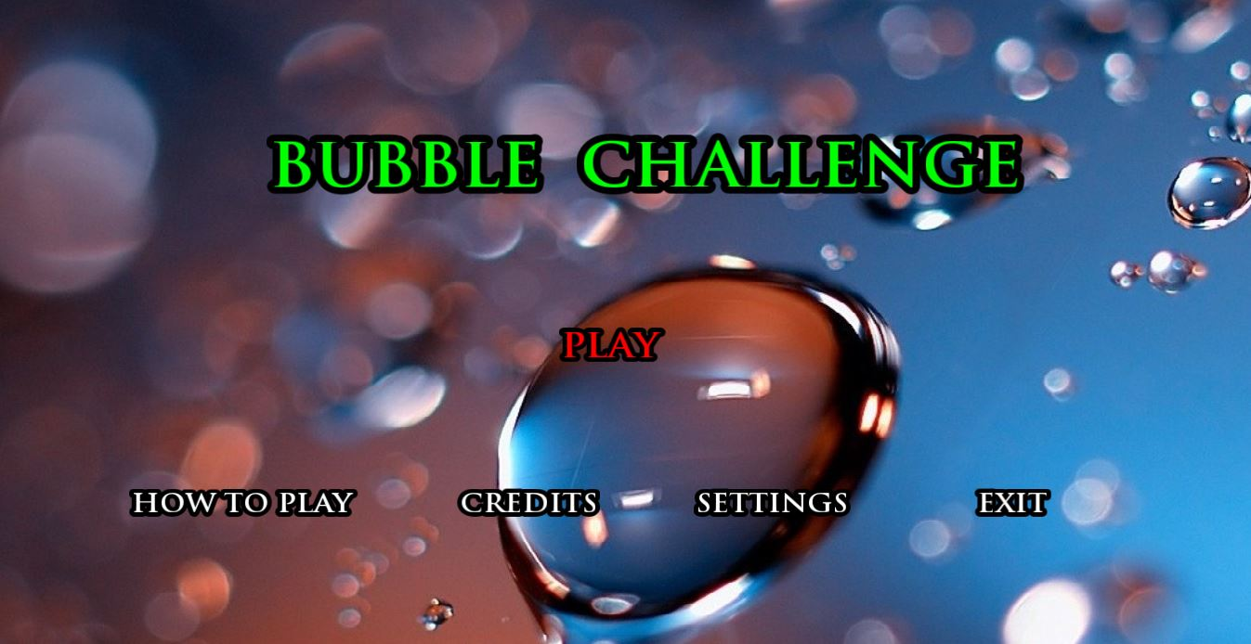
Gaming Window Menu
B T

Slide 9
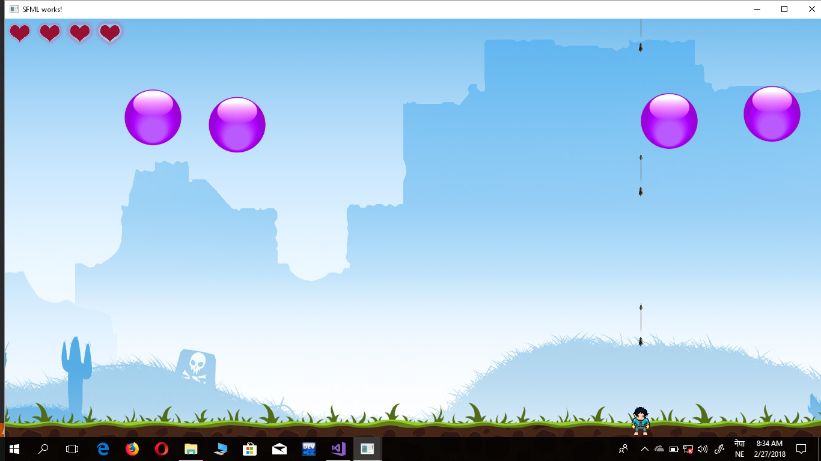
Gaming Window
B T

Slide 10
Problem Faced And Solutions
Flickering of graphical components.
- Due to lag in rendering the update to the new window solved using deltatime concept
Problem faced in the collision between the bubble & player for life reduction.
- made ball bounce back on first collision
Lag in the movement of the when played in two player mode
- Due to connection issue and slow transfer of game data solved
B T

Slide 11
Limitation And Further Enhancement
Only one level due to short span of time
Could be developed with many levels in the future.
The facility of playing with more than two players can be added up in the future
More users can play & compete in same game play
B T

Slide 12
Conclusion
Implementation of the theoretical knowledge of OOP approach to building a realtime game app
Development of concept and skills on Project Management with additional knowledge on graphics
Sense of professionalism and advantage of working together as a team
B T

Slide 13
Reference
Books:
The secrets of Object Oriented Programming in C++
Daya Sagar Baral
Diwakar Baral
E-books:
SFML Game Development
Artur Moreira
Henric Vogelius Hansson
Jan Haller
Websites:
https://www.sfml-dev.org
http://www.dsbaral.com.np
https://www.gamedev.net
https://www.youtube.com
B T

Slide 14
Thanking You All
B T

